Slide 1
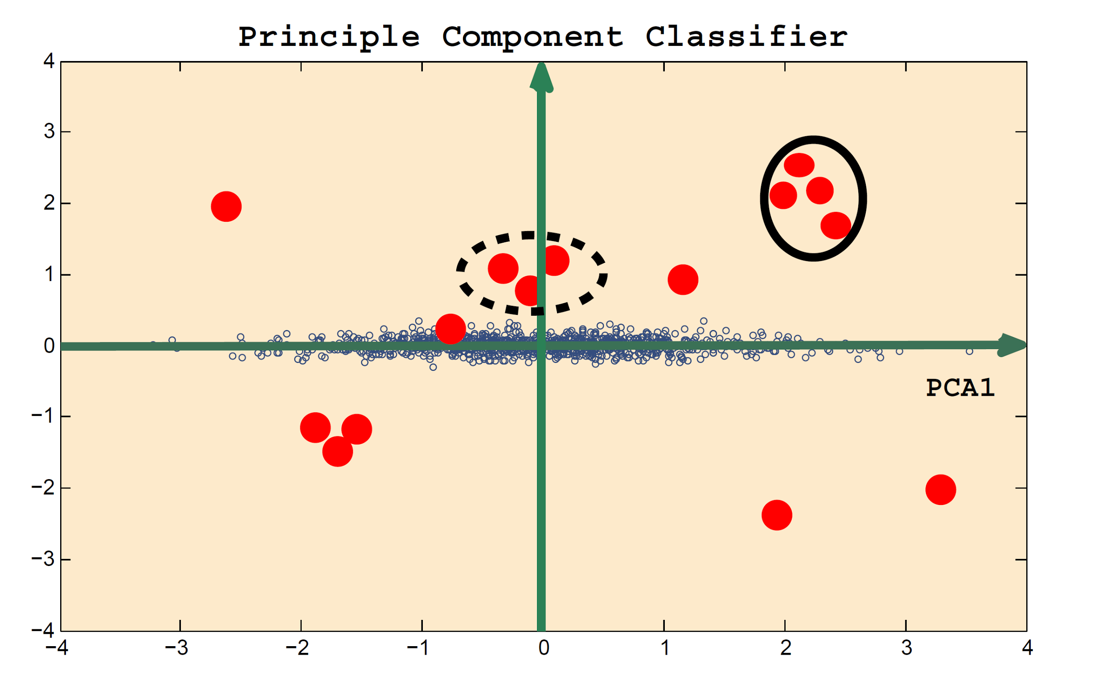
Principal Component Classifier (supervised learning)
X1
Classified as “abnormal” if
PCA2
X2
or
else
classified as “normal”
Ref.: A Novel Anomaly Detection Scheme Based on Principal Component Classifier
NRL Release Number 03-1221.1-2312
Authors: Mei-Ling Shyu, Shu-Ching Chen, Kanoksri Sarinnapakorn, and LiWu Chang

Slide 2
Principal Component Classifier Results
Unshuffled Train and Test data:
Performance on original features:
Accuracy: 80%
True positive rate: 92%
False positive rate: 29%
Performance after adding predicted probabilities from logistic regression:
Accuracy: 83%
True positive rate: 92%
False positive rate: 13%

Slide 3
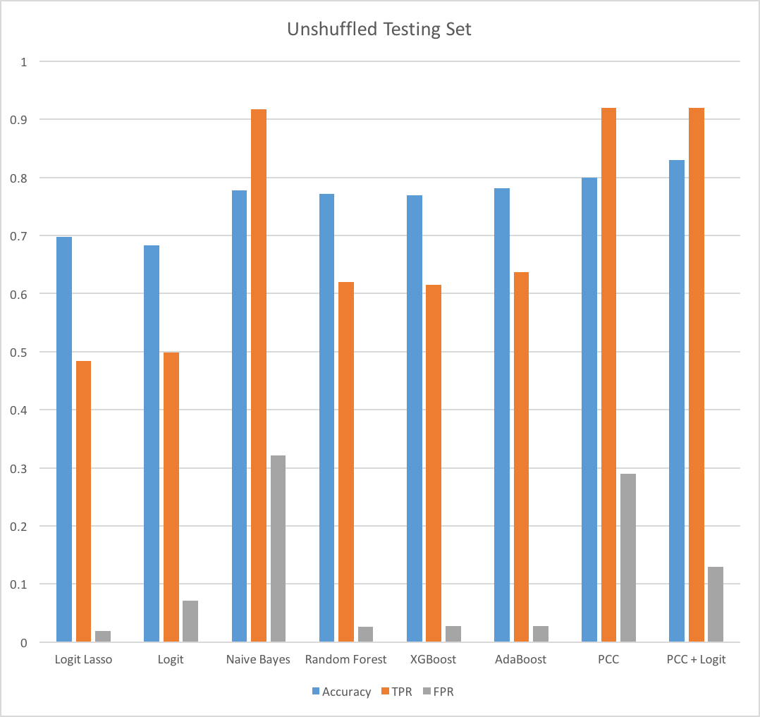
Model Comparison
Note:
TPR: True Positive Rate (higher is better)
FPR: False Positive Rate (lower is better)

Slide 4
Conclusion
After shuffling training and test datasets, all models perform dramatically better, especially random forest. However, this approach is flawed as new, unknown attacks are routinely encountered in real-world scenarios
Basic PCC and naive Bayes models outperform others used in this analysis, especially when new attack patterns are not present in the training dataset
Further development of PCC and naive Bayes models could lead to even better model performance for anomaly detection

